Slide 1

Sentiment Analysis For Business Analytics
Noah Gift
Lecturer UC Davis MSBA (Cloud, Machine Learning)
Founder @Pragmatic AI Labs
Author Pragmatic AI

Slide 2




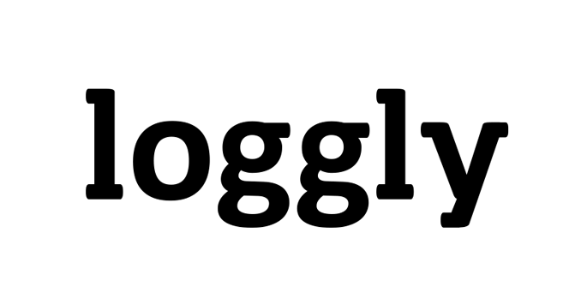















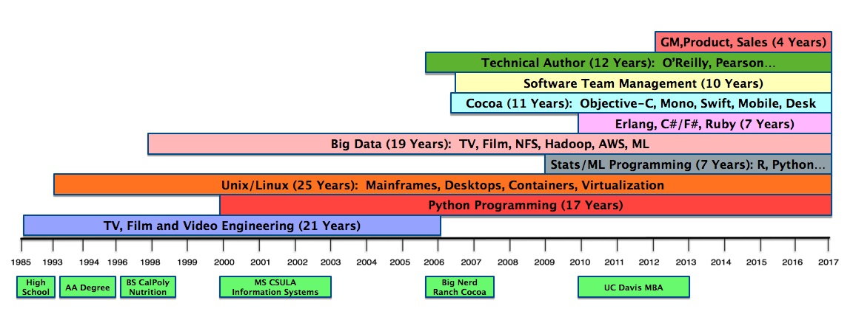







Lead Systems Administrator
Director Engineering
Network News Editor/Engineer
Lead Editorial Engineer
Lead Python Developer
Python Developer
CTO & GM
Consultant & Professor
Pearson Book on AI
School & Work Full-time
Wrote O’Reilly Book on Python
Worked on Avatar Movie
School & Work Full-time
Wrote Best Selling OS X App

Slide 3


MBA Background
Why I decided on an MBA
What I learned
How it helped me
Why I am teaching at UC Davis

Slide 4
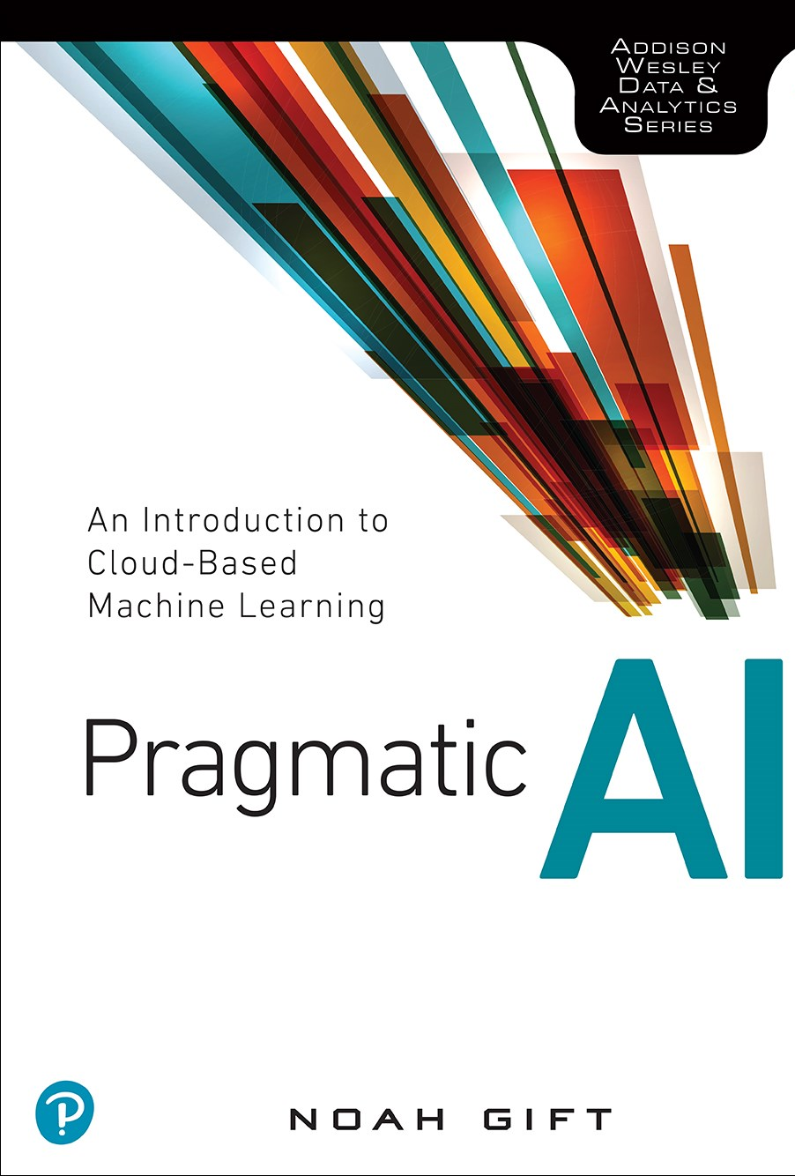
Pragmatic AI Book Theme
Produce Results
Use the cloud…“cloud-native”
Data Science is a capability not a job title

Slide 5
Datascience Workflow
Ingest
EDA (Exploratory Data Analysis)
Modeling
Conclusion

Slide 6
Sentiment Analysis Problem Definition
Use ”off the shelf” AWS Comprehend software to analyze customer sentiment
Dataset is 5,000 customer reviews of appliances
Perform Data Science

Slide 7
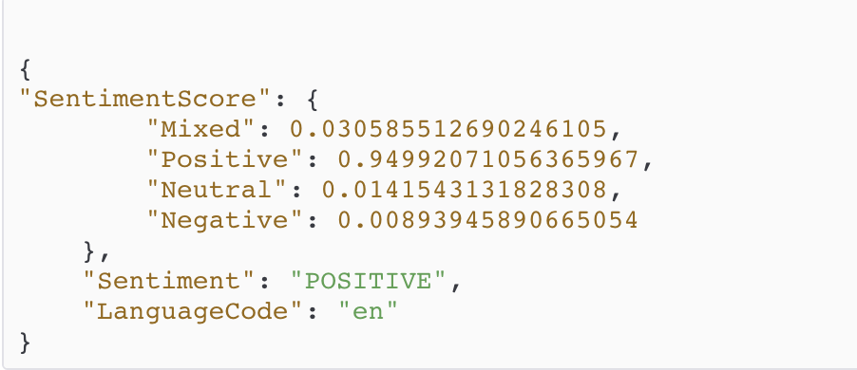
What is Sentiment Analysis?
Part of Natural Language Processing Field
Classifies Text into a sentiment category
Typical classifications: Negative, Neutral, Mixed, Positive
Often has numerical probability score associated with each category

Slide 8

Business Use Case of Sentiment Analysis
Customer Support
Brand Loyalty
Digital Marketplace
Human Resources

Slide 9


Data Science with Russian Dolls
Tensor Flow SDK
Keras SDK
Ludgwig AutoML
Google AutoML
Google Vision API

Slide 10

Critical Choice in Data Science
Which layer are you working at?
Why?

Slide 11
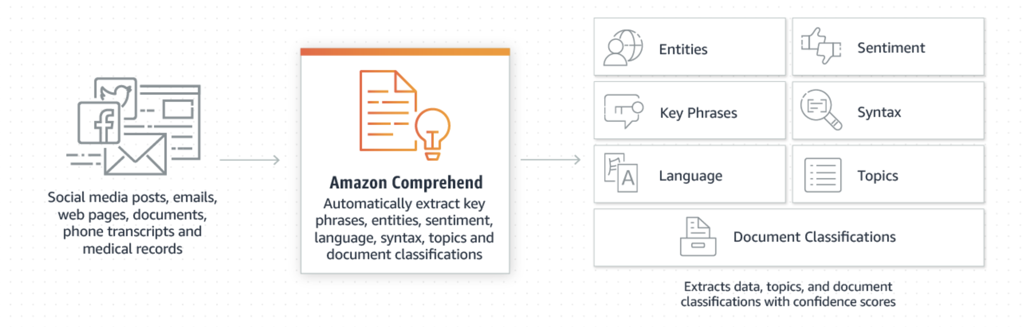
Using AWS Comprehend
DEMO

Slide 12
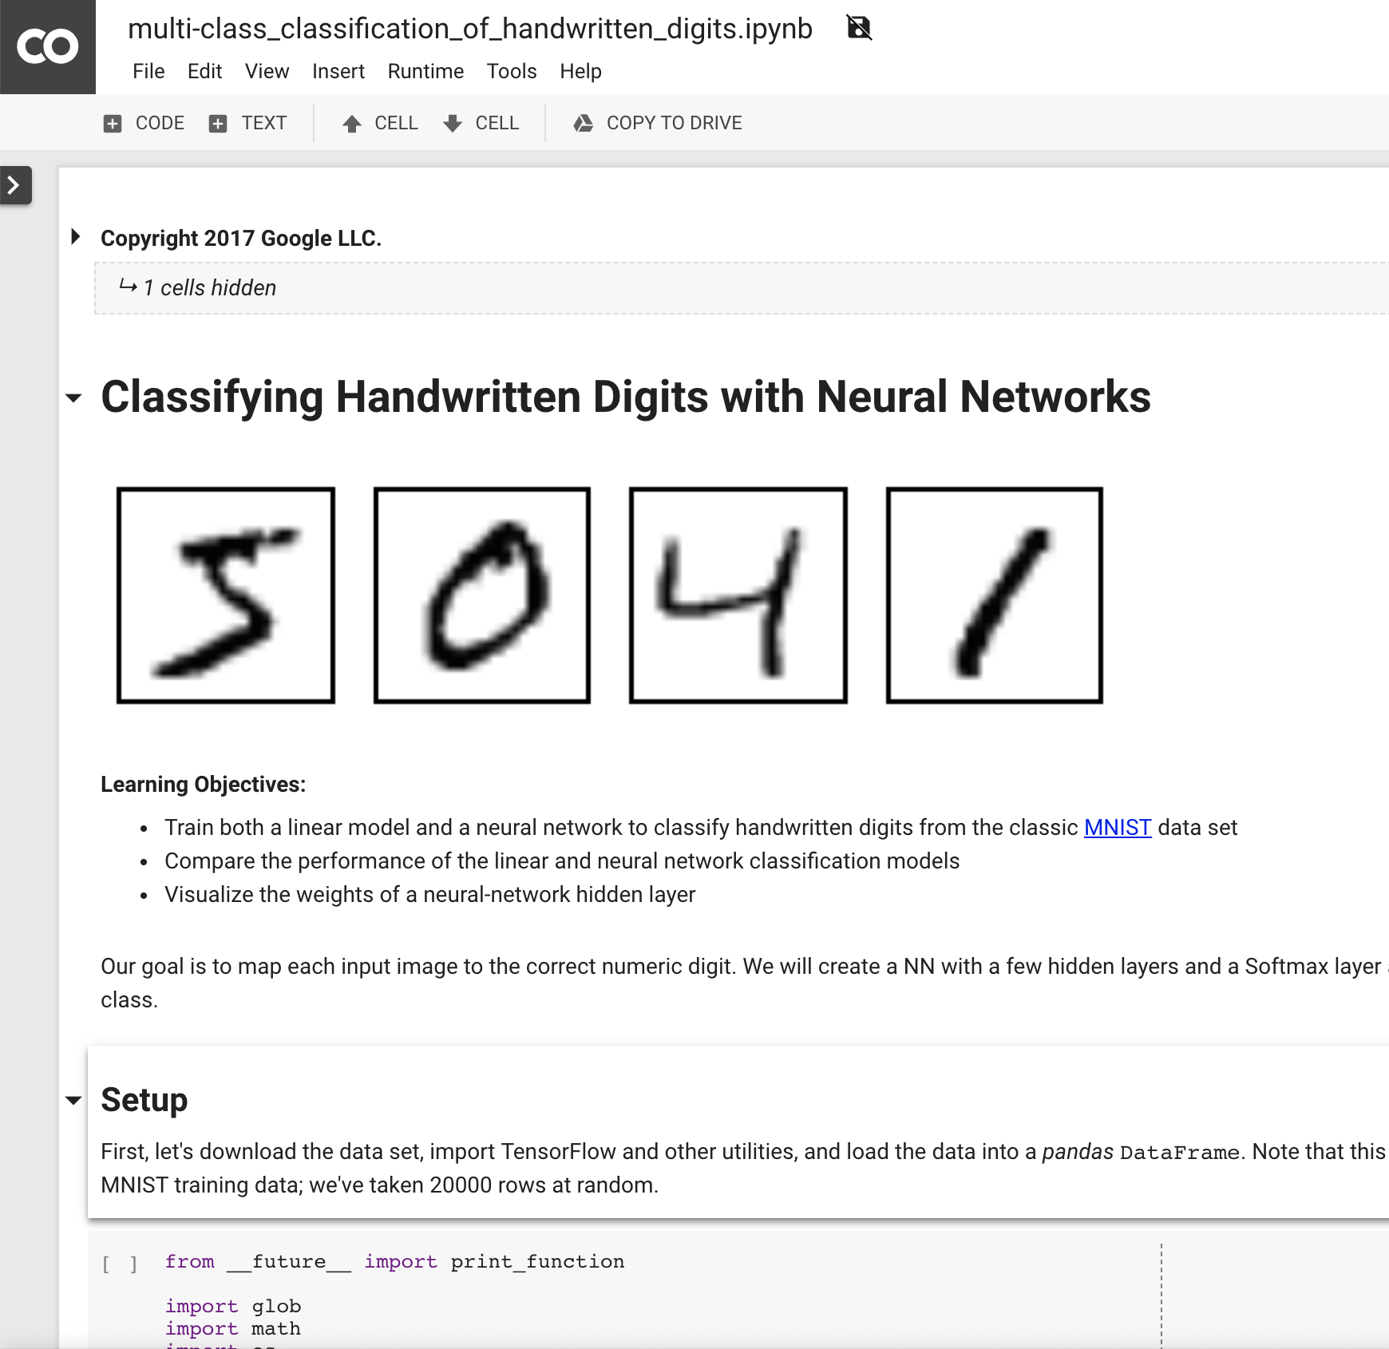
Colab Notebook Demo
Notebook URL

Slide 13

Project Deliverable
Follow the Datascience workflow: Ingest, EDA, Modeling, Conclusion
Analyze customer sentiment using AWS Comprehend
Report your conclusion to class (1 minute)
Time Management Advice:
Spend 50% of time on analysis
Spend 50% of time on conclusion (report)

